Slide 1
Machine Learning for RRP Robotic Arm Control
Omar Ramadan
Omar Amr
Ahmed Hossam

Slide 2
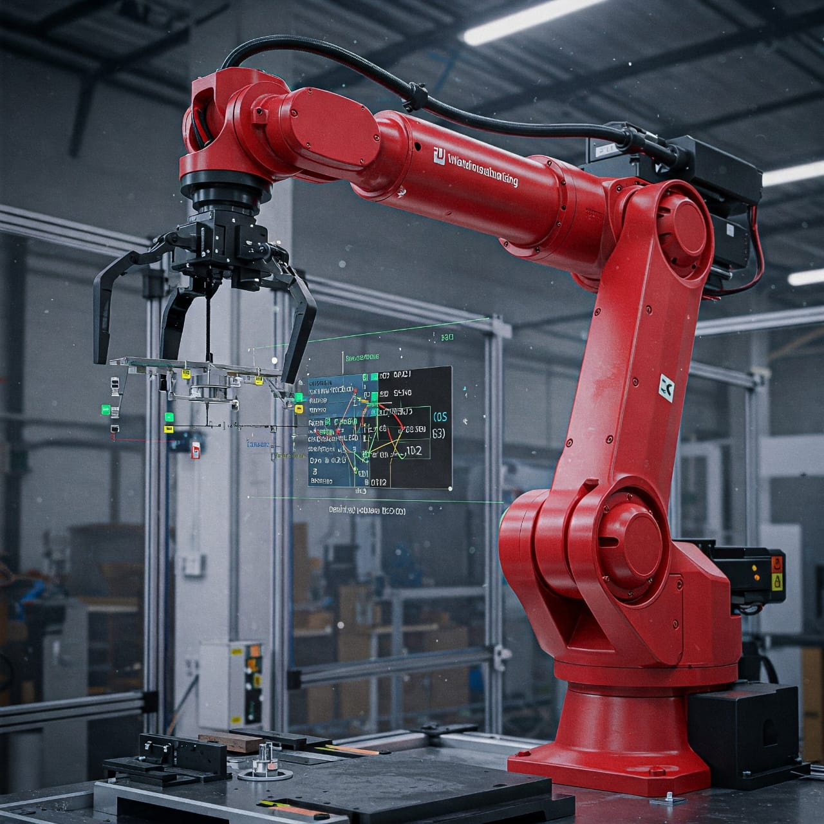
Introduction
Project Goal: This project focuses on controlling a 3-DOF robotic arm with an RRP (Rotational-Rotational-Prismatic) configuration using Machine Learning. The aim is to predict the joint values needed to reach a specific end-effector position in 3D space (X, Y, Z).
Why ML? Instead of solving complex inverse kinematics equations, ML models can learn the relationship between the end-effector position and the required joint values from data, making the control process more efficient and flexible.

Slide 3
01 What is an RRP Robot?
RRP Arm Structure: Rotational Joint (θ1): Base rotation in the XY plane. Rotational Joint (θ2): Shoulder joint rotating another link. Prismatic Joint (d3): Linear actuator moving the arm vertically. Motion Capabilities: The robot operates in a 3D space and can reach various positions by adjusting θ1, θ2, and d3. .

Slide 4
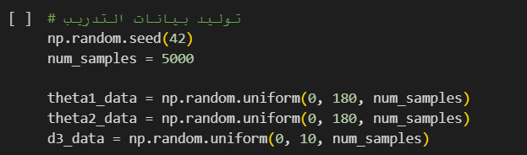
Dataset Description
Input Features (X):
Target end-effector positions in 3D space: (x, y, z)
Target Values (Y):
Corresponding joint values: (θ1, θ2, d3)
Data Generation:
The dataset was synthetically generated using forward kinematics equations by sampling valid θ1, θ2, and d3 values, and computing the resulting x, y, z positions.
Sample Size:
Approximately 1500 samples were created to train and evaluate the models.

Slide 5
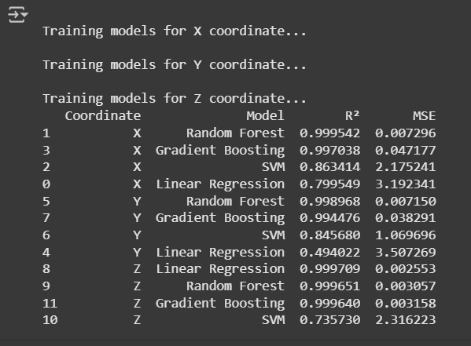
Machine Learning Models Used
Linear Regression
Random Forest Regressor
SVM
Gradient Boosting

Slide 6
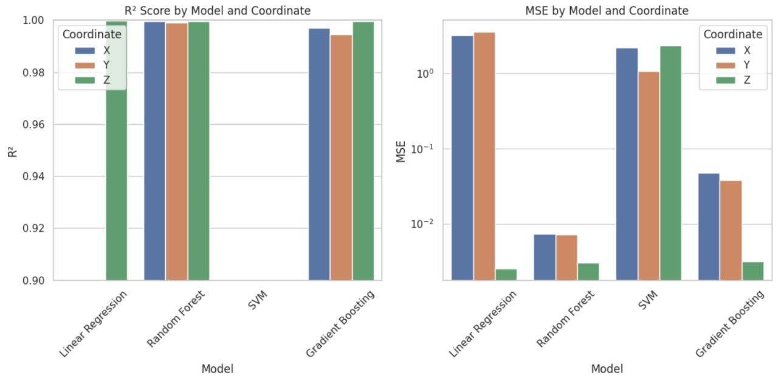
Model Performance Comparison

Slide 7
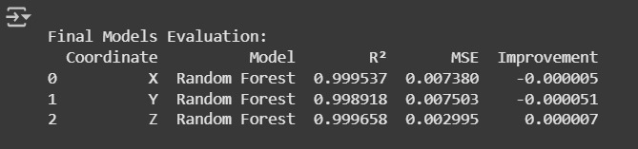
Best Performing Model
Best Model:
Random Forest Regressor was the most consistent model across all coordinates.
Why It Stood Out:
Captured complex, nonlinear relationships.
Achieved the highest R² scores across all output dimensions (X, Y, Z).
Performed well without significant overfitting.
Example R² Scores (approx.):
X: 0.9995
Y: 0.9989
Z: 0.9996

Slide 8
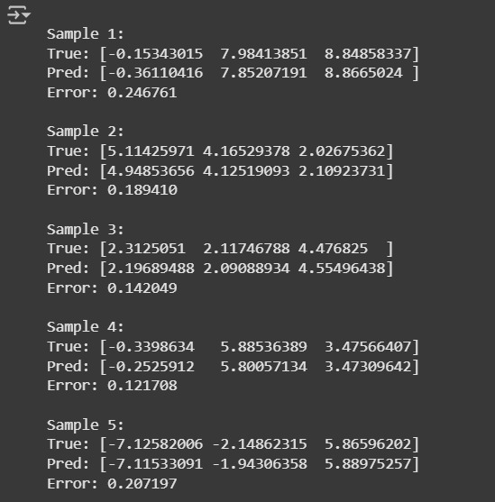
Error Analysis
We evaluated the model's predictions not just with R², but also by analyzing the Euclidean distance between predicted and actual joint parameters

Slide 9
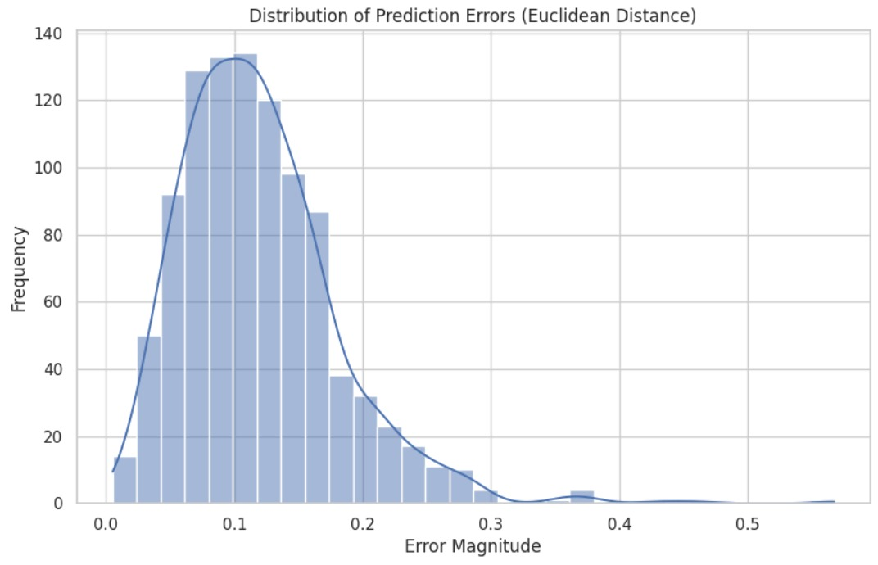
Prediction Error Distribution
We computed the Euclidean error for all test samples and visualized its distribution.The histogram shows that most predictions had errors between 0.0 and 0.3, confirming the model's accuracy..

Slide 10
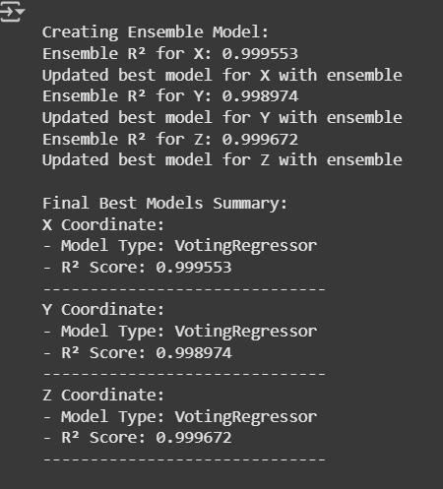
Ensemble Learning
Benefits of Ensembles:
Handle non-linear data well.
Reduce variance and overfitting.
Deliver higher accuracy than single models

Slide 11
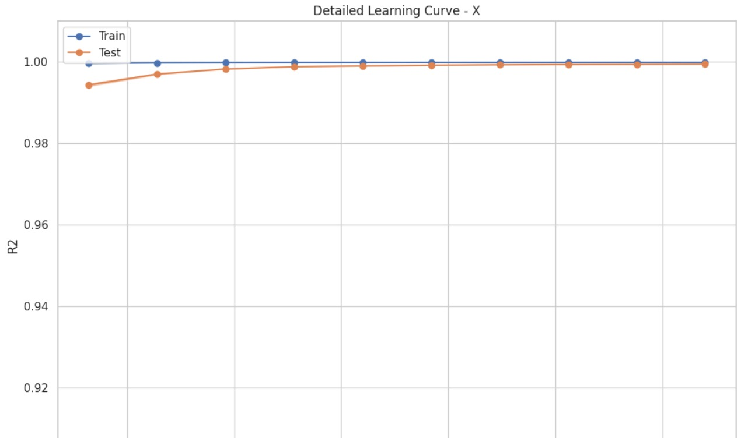
Learning Curve
A learning curve shows how the model’s training and validation scores evolve as the training size increases.

Slide 12
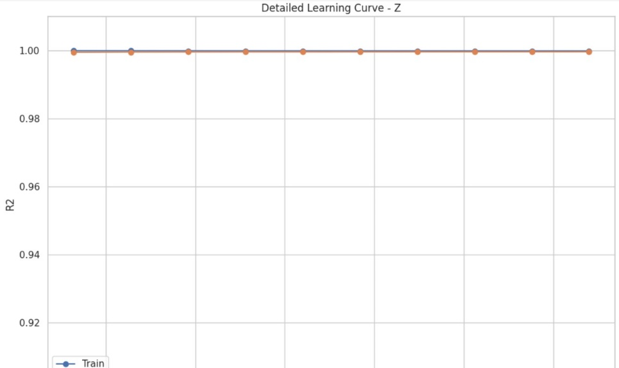
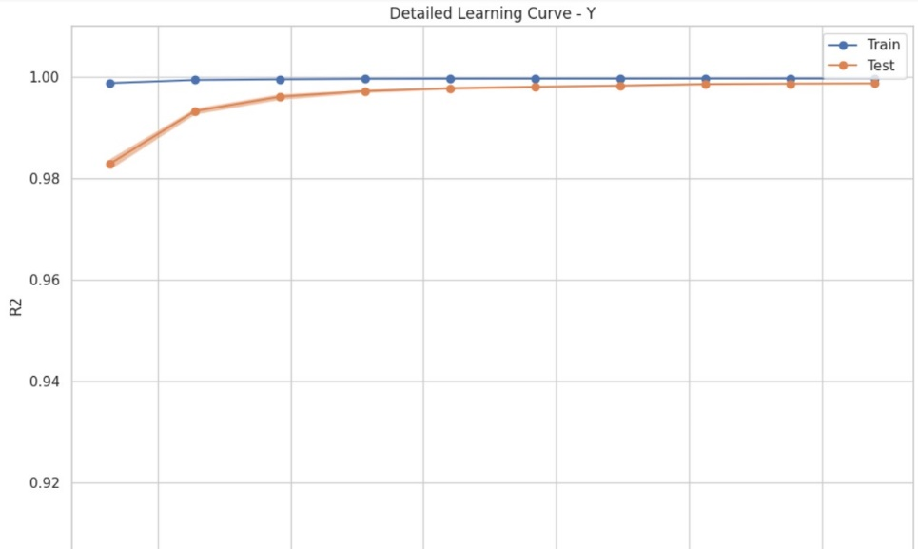
Learning Curve

Slide 13
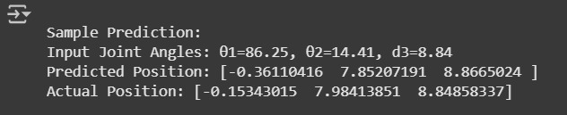
03 Testing and Predictions
Testing Strategy: 20% of the dataset was reserved for testing unseen examples. Models were tested individually for each output variable. Prediction Example:Input: (x, y, z) = (5.2, 3.1, 7.0) Predicted Joint Values: θ1 ≈ 86.25 θ2 ≈ 14.41 d3 ≈ 8.84 Observations: Predictions were close to true values. Very low MSE indicates strong performance.

Slide 14
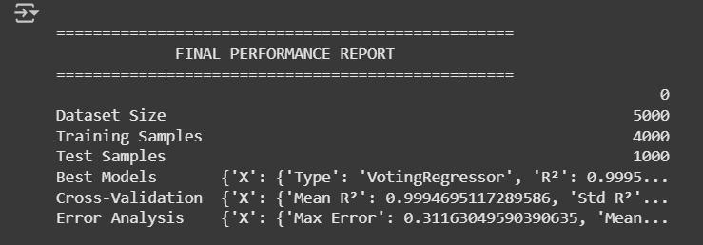
Conclusion
Machine Learning provides an efficient and flexible solution for robotic arm control.
Random Forest was the best-performing model in predicting joint values from end-effector positions.
This approach reduces the need for complex inverse kinematics calculations.

Slide 15
Thank You Any Questions?

